Slide 1
Banking data
Analysis
Prepared by
Diadchenko Volodymyr
Tools Used:
Google Sheets | MySQL | Python | Power BI

Slide 2
Introduction
Problem:
The bank manager has noticed a decline in income from banking services.
Data suggests that the number of active customers is decreasing — but why?
Goal:
Identify customer behavior patterns to understand why users are leaving.
Build a classifier to predict whether a customer will leave the bank in the next 6 months.

Slide 3
Tools used:
MySQL: Exploring and aggregating data to check customer behavior patterns and support hypothesis testing
Python: Cleaning, merging datasets, running EDA, feature engineering, and building a churn prediction model
Power BI: Creating clear and interactive dashboards to visualize churn trends and customer segments
Notes:
In this project, I combined SQL for data exploration, Python for analytical modeling, and Power BI for business-friendly visualizations. Each tool was selected for what it does best.

Slide 4
Hypotheses:
Inactive customers are more likely to leave
More products = higher retention
Geography influences churn
Low credit score increases churn risk
Younger customers churn more
Notes:
I’ve decided to explore five core hypotheses that could explain why customers are leaving the bank. First, I tested whether inactive members are more likely to churn — this is often the case in service industries. Then I checked credit score, assuming that lower scores might relate to financial instability or dissatisfaction. I also looked at the number of products — the idea is that customers who use more services might be more engaged and less likely to leave. Since the data includes Geography, I compared churn across regions to uncover potential market-specific differences. Finally, I analyzed age — suspecting that younger customers might be more flexible and prone to switching banks.

Slide 5
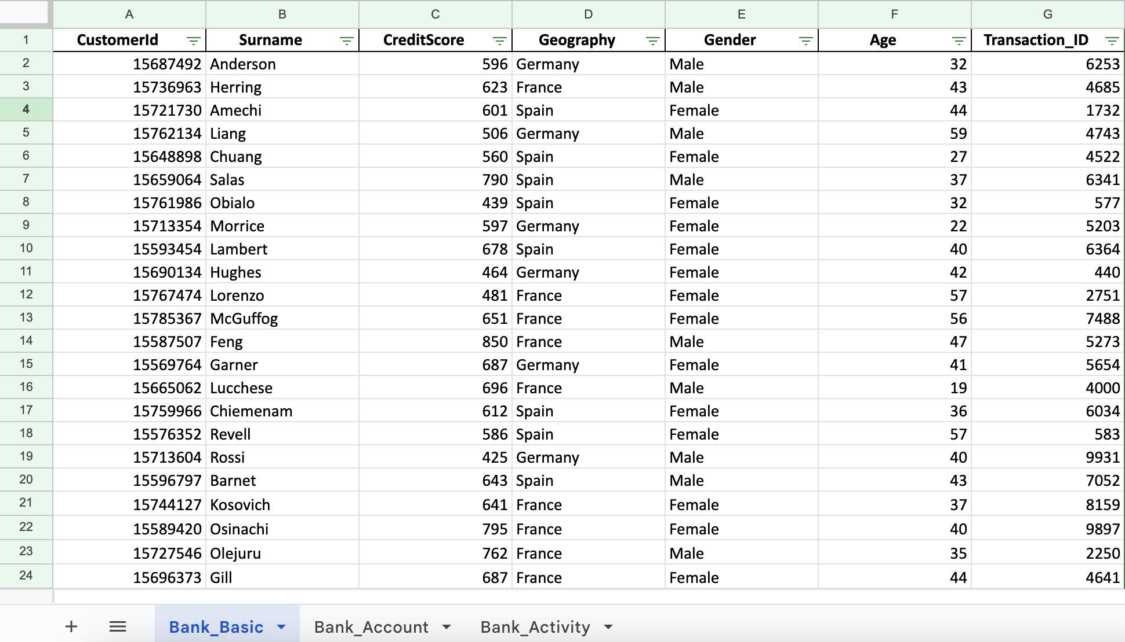
Dataset & Preparation.
Original file: Bank_base.xlsx
After checking for incorrect values, missing data, and format inconsistencies, the dataset appeared to be clean and required no fixes.
It is ready for further analysis.

Slide 6
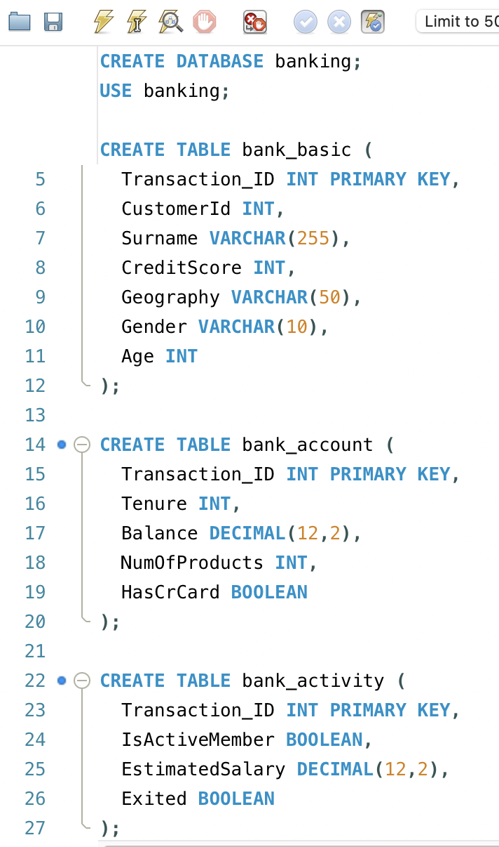
Data Loading into MySQL
Step 1: Created a new schema
I started by creating a dedicated schema in MySQL for this project — named banking.
Step 2: Created 3 tables
Tables were created manually with appropriate column types to match the datasets.
Step 3: Imported data using Table Data Import Wizard
I used the built-in Table Data Import Wizard in MySQL Workbench to upload all three CSVs.
Each table was checked for proper row count and format after import.

Slide 7
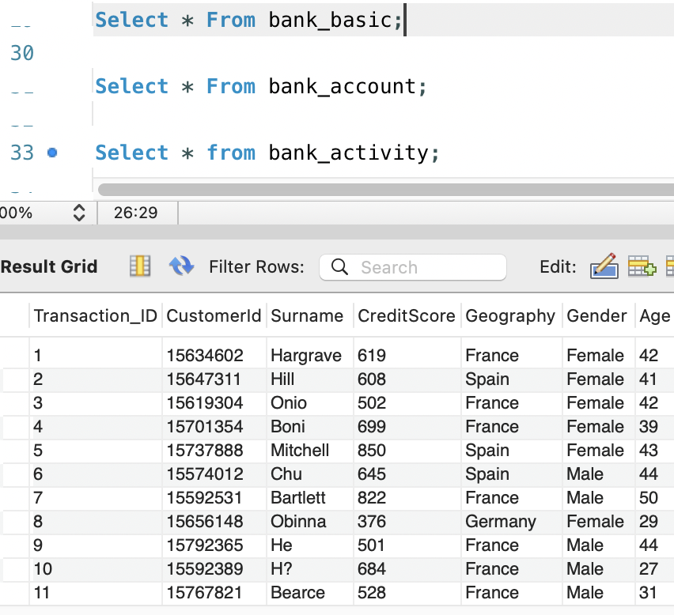
Basic MySQL manipulations.
Initially I performed basic commands to check if the data looks good and was exported correctly to mySQL:
View samples of each table: SELECT * FROM bank_basic LIMIT 10;
2. Checked the row count for each table: SELECT COUNT(*) FROM bank_basic; There is 10000 rows in each

Slide 8
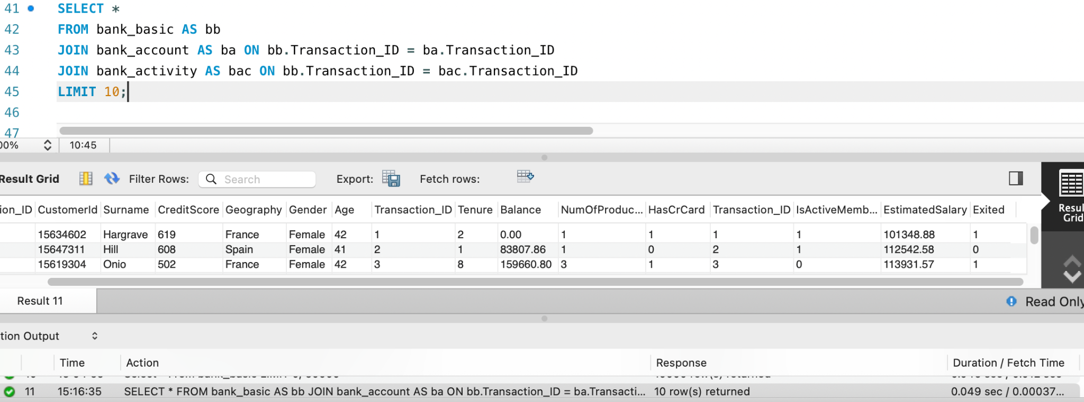
Joining tables in MySQL
For the further analysis it is important to JOIN our tables:

Slide 9
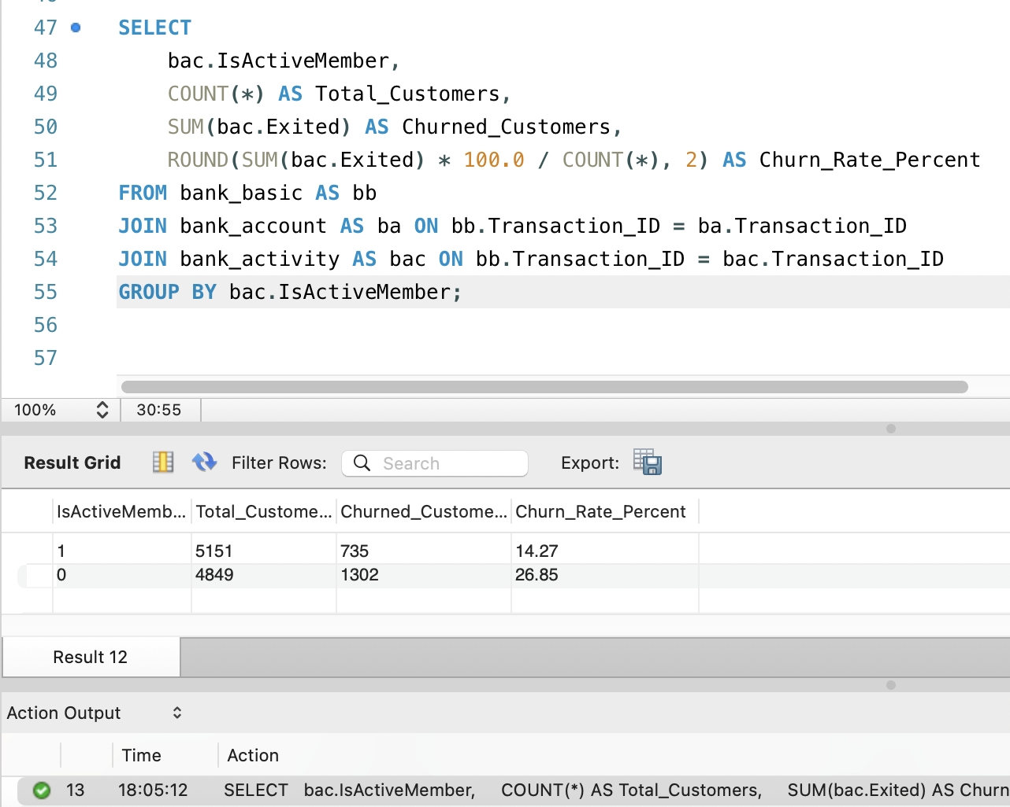
Hypothesis 1: Churn by IsActiveMember
➔ What & Why:
I grouped customers by IsActiveMember and calculate churn rate.
To test if being inactive is associated with a higher chance of leaving the bank.
Conclusion: The churn rate among inactive members is 26.85%, nearly double that of active members, who churn at 14.27%.
This confirms our first hypothesis — inactive customers are significantly more likely to leave the bank.
Notes:
This slide tests our first hypothesis: that inactive customers are more likely to leave. I used SQL to group users by their activity status and calculated the churn rate for each group.The results clearly show that inactive members churn at a much higher rate — 26.85%, compared to 14.27% for active ones. This confirms that user engagement is a key predictor of churn and should be a focus area for retention efforts.

Slide 10
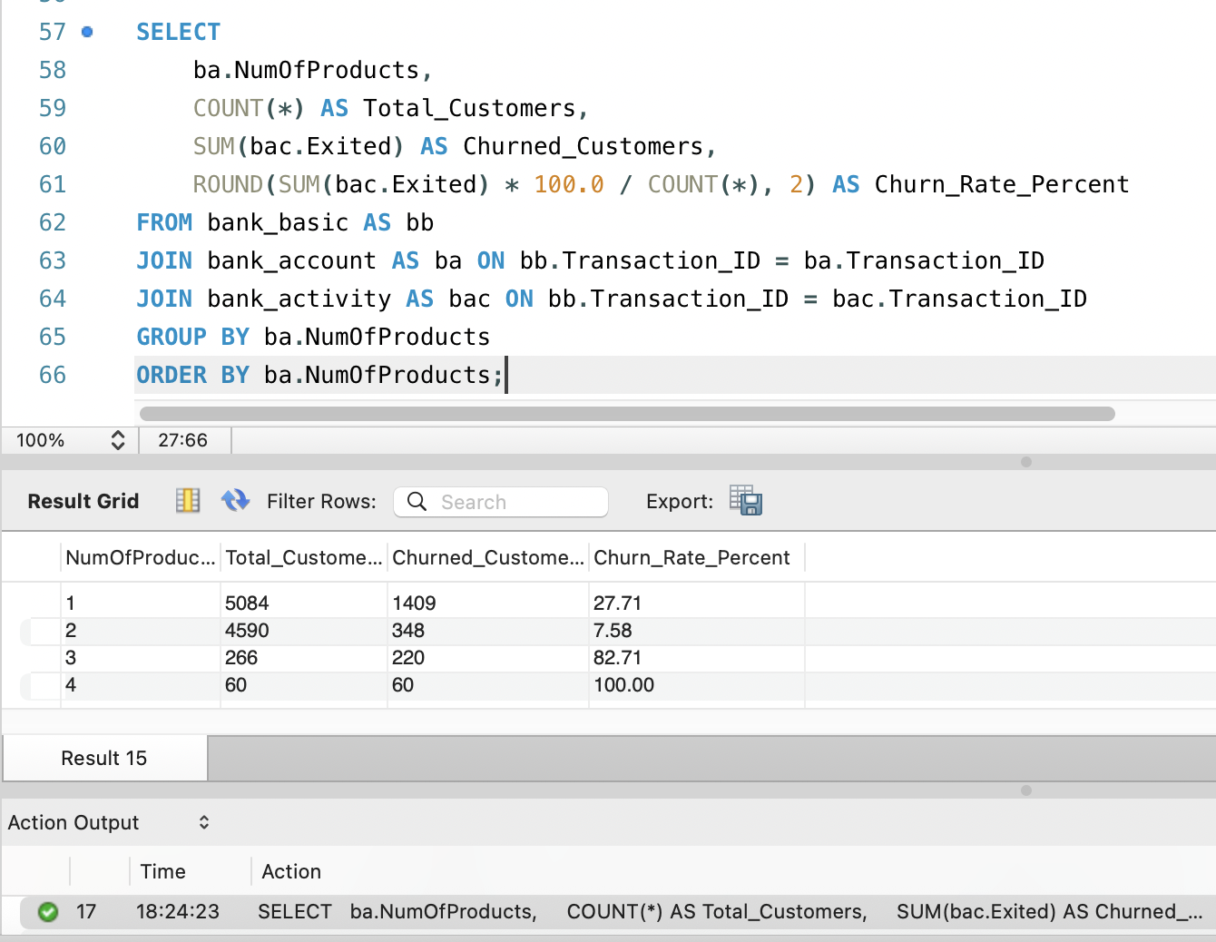
Hypothesis 2: Churn by Number Of Products
➔ What & Why:
Analyze churn rate by the number of products held by the customer.
To understand if multi-product users are more loyal.
Conclusion: The churn rate for users with 2 products is the lowest: 7.58%, compared to 27.7 for users with just one product. However, churn spikes sharply for those with 3–4 products, suggesting possible technical issues.
Therefore, the hypothesis is partially confirmed — more products may reduce churn up to a point
Notes:
While churn rates are extremely high among customers with 3 and 4 products, these segments are very small in total population. This could point to technical issues or poor experience with bundled services that require urgent review.
Meanwhile, customers with 2 products show the lowest churn rate, suggesting that a moderate level of engagement builds loyalty.
Therefore, the hypothesis is partially confirmed — more products may reduce churn up to a point, but oversaturation or mismanagement of complex packages may have the opposite effect.

Slide 11
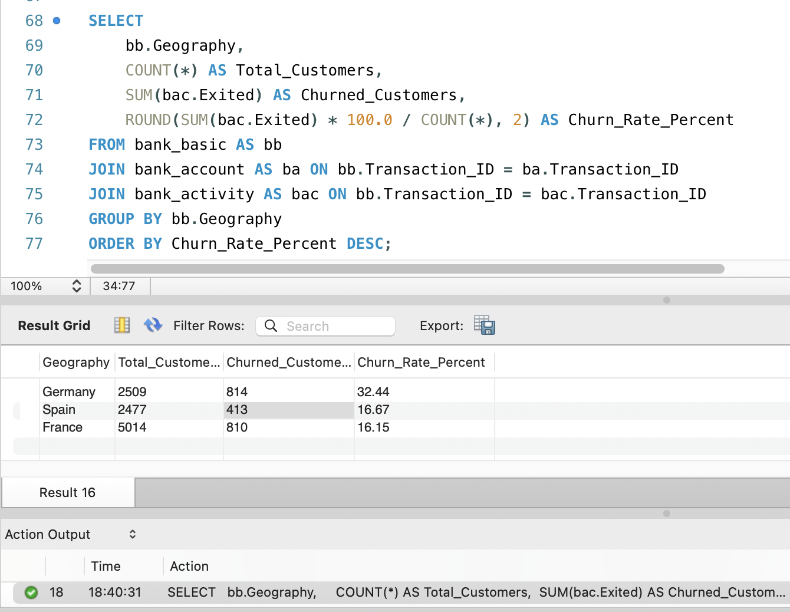
Hypothesis 3: Churn rates vary significantly between countries.
➔ What & Why:
Group customers by country and calculate churn rate.
To identify regional differences in customer loyalty and performance.
Conclusion: Germany shows the highest churn rate (32%). Spain and France, while having different user count, are nearly half that.
The hypothesis is confirmed: churn varies strongly by geography.
Notes:
This query confirms that churn patterns differ across countries. Germany’s churn rate is twice as high as Spain and France.
That suggests possible local issues — such as lower service satisfaction, uncompetitive products, or cultural differences in loyalty.
I recommend Germany be prioritized for further research and retention strategies.

Slide 12
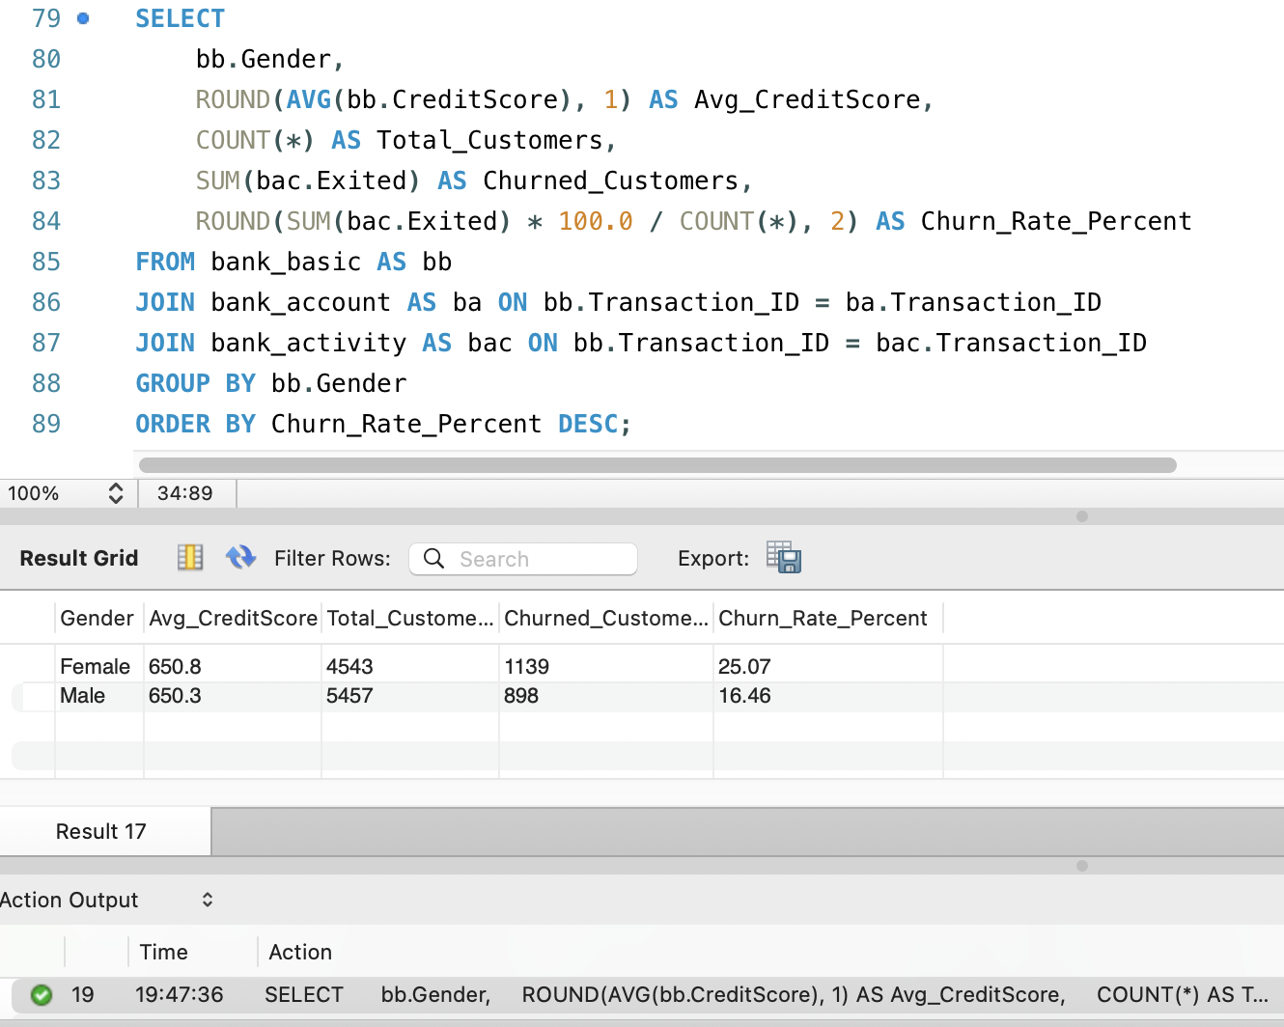
Digging deeper: Churn by Gender and Credit Score
➔ What & Why:
Group by gender and use AVG(CreditScore) + churn metrics .
To check if churn is connected to gender or financial reliability (via credit score).
Conclusion: Churn is significantly higher among female customers (25%) than males (16%), even though credit scores are nearly identical.
This points to behavioral or experiential factors, not just financial ones.
Notes:
Despite male and female customers having almost the same average credit score (~650), female customers churn 1.5x more. This indicates that credit score alone doesn’t explain churn — the bank should investigate whether communication style, product fit, or support quality differs by gender.

Slide 13
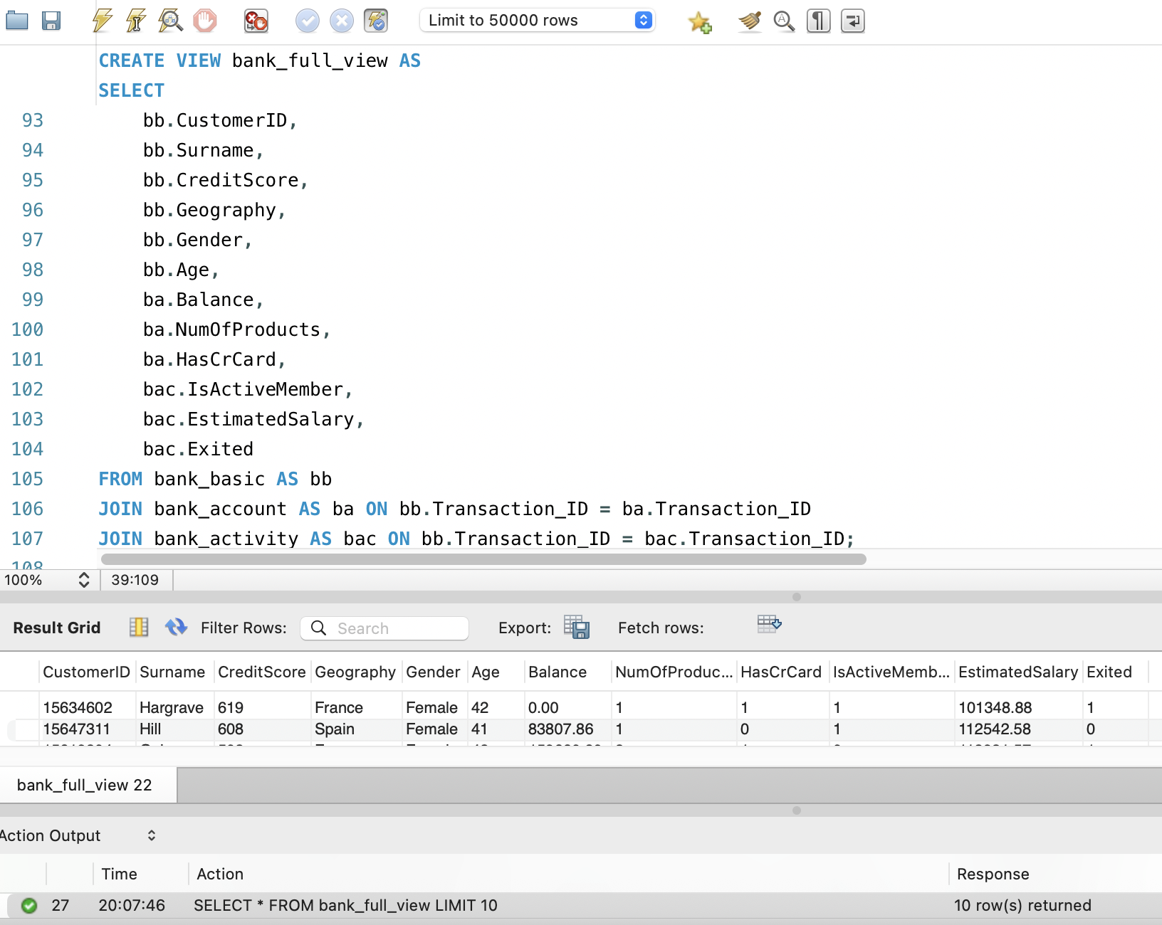
MySQL: Creating a view
➔ What & Why:
Create a SQL VIEW that joins all three tables (bank_basic, bank_account, bank_activity) into one unified structure.
This allows me to reference a clean, merged dataset repeatedly in queries for the future analysis.

Slide 14
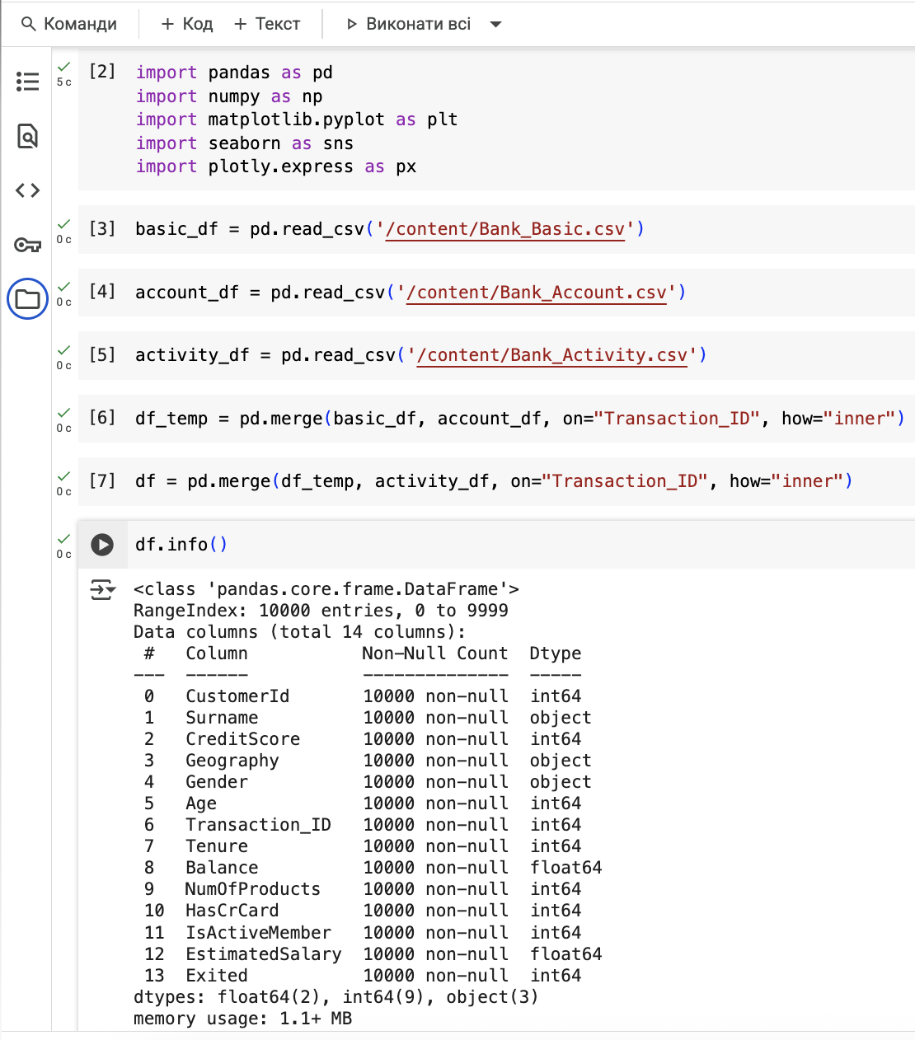
Merging Datasets in Python
Uploaded all 3 datasets
Merged three original datasets on Transaction_ID
Result: 10,000 customers × 14 columns
All values are complete and clean
Notes:
In this step, I loaded the three CSVs using pandas and merged them into a single DataFrame using the Transaction_ID key. This allows us to combine customer data, account details, and activity records into one place for analysis. I used an inner join to ensure only customers with complete records are included. The final dataset has 10,000 rows and no missing values — ready for exploration and modeling.

Slide 15
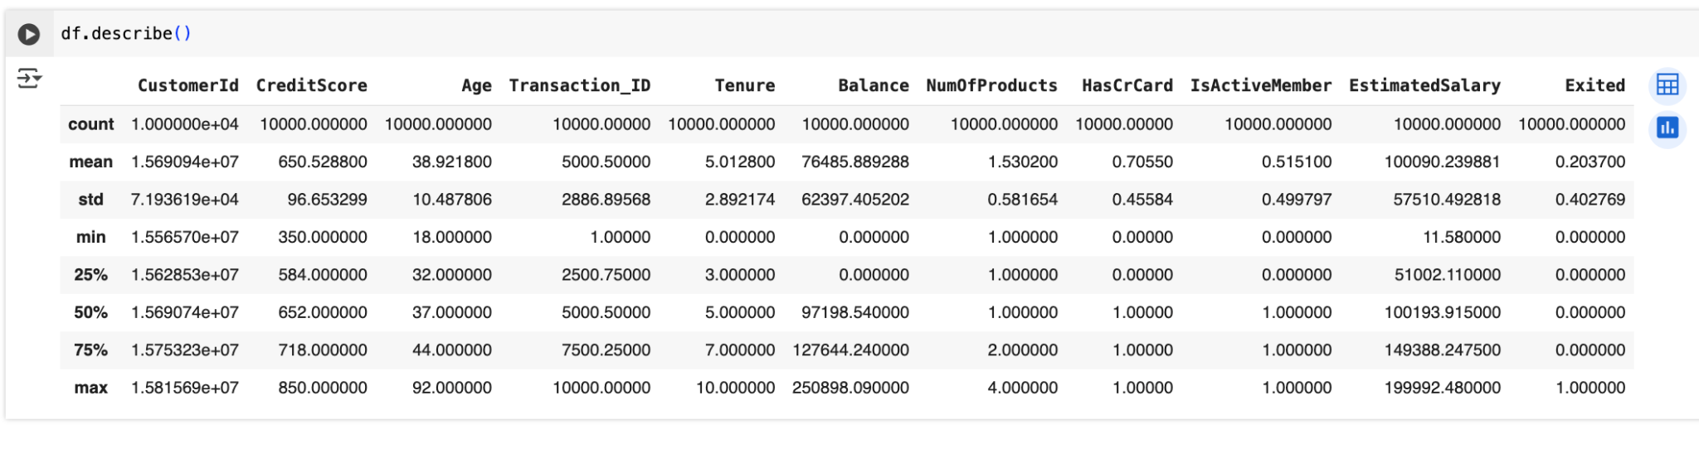
Basic EDA using df.describe()
Churn rate ≈ 20% — matches what we found in SQL.
Credit Score: 350–850, centered around 650.
Age: median age is ~37, but some customers are quite old (up to 92).
Balance: many have 0, but some exceed 250k — wide disparity.
EstimatedSalary: evenly spread, with no extreme outliers.
The churn rate seems to match what we observed in SQL.
Notes:
I used the describe() method to generate summary statistics for all numeric columns in our merged dataset. This summary helped us check for data consistency and shape.
Churn rate matches our SQL findings (≈20%).
Credit Score is centered around 650, and age skews around 37.
Balance has large gaps — many users have 0, some have over 250K.
No major outliers in salary — data looks solid for analysis.

Slide 16
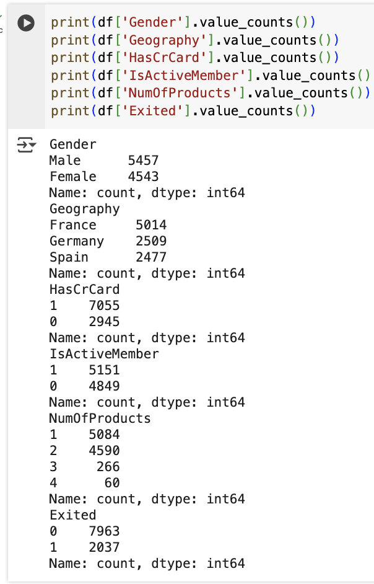
Categorical Distribution Overview
Slightly more male than female customers (≈54.5% vs 45.5%).
Majority of customers are from France.
About 70% have a credit card, while 30% do not.
Customers are evenly split between active and inactive members.
Most users use 1 or 2 products, very few use more.
Only 20% of customers exited (churned).
Notes:
This slide gives a quick profile of our customer base. Most are from France, evenly split between genders, and half are not active members. Around 70% use a credit card. Interestingly, 80% of customers stayed, meaning we have enough positive examples for building a good classifier later.

Slide 17
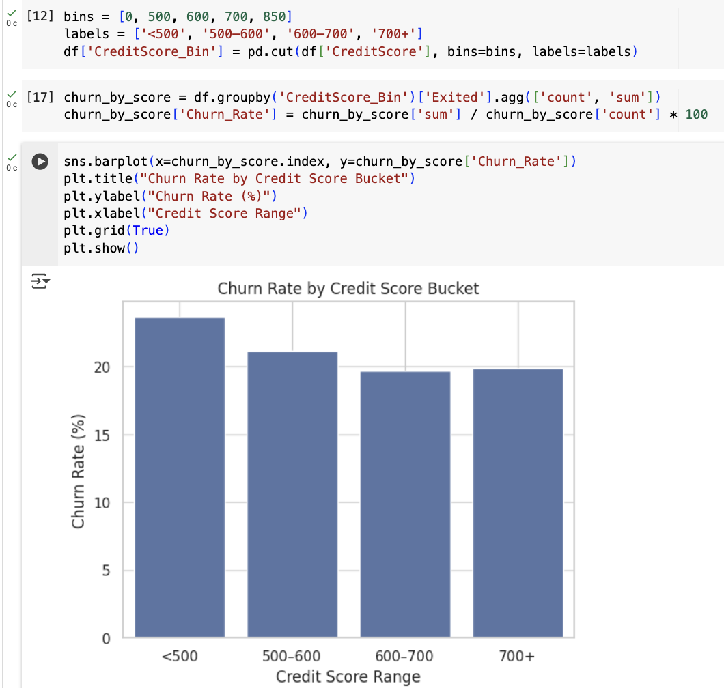
Hypothesis 4: Low credit score increases churn risk
What we’ll do:
Bucket customers by Credit Score ranges (e.g. <500, 500–600, 600–700, >700).
For each bucket, calculate churn rate.
Visualize with a barplot to see the trend.
Customers with credit scores under 500 have the highest churn rate. However, overall churn remains relatively steady across score ranges, so the hypothesis is partially supported.
Notes:
This plot helps us explore the assumption that low credit scores lead to churn. While customers with scores below 500 show the highest churn (~24%), the decline across other ranges isn’t steep. This suggests that credit score alone is not a strong predictor of churn, and it should be used in combination with other features in the classifier.

Slide 18
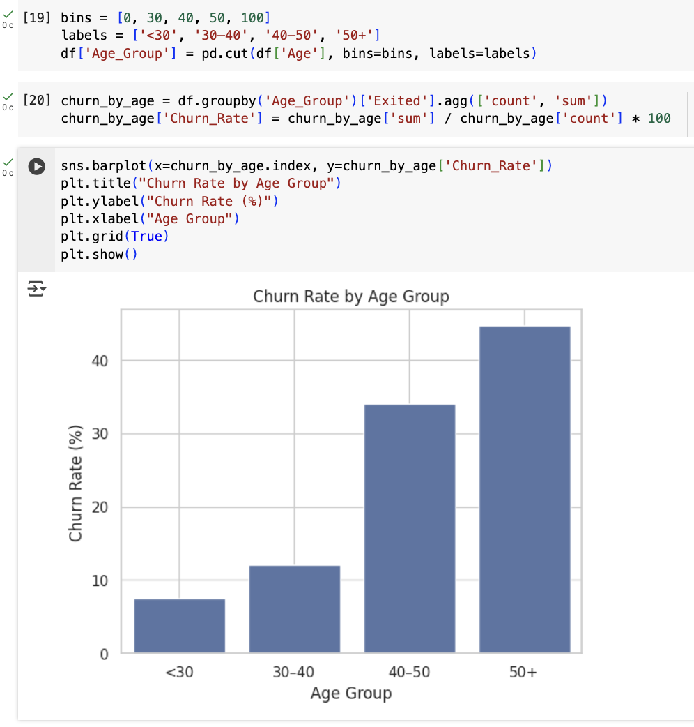
Hypothesis 5: Younger customers churn more
We’ll bin customers into age groups (e.g., <30, 30–40, 40–50, 50+) and calculate the churn rate in each group to visualize the relationship between age and churn.
Hypothesis not confirmed.
The data shows the opposite: churn rate increases with age.
Customers under 30 have the lowest churn (~8%).
Those 50+ churn the most (~45%).
This disproves the hypothesis and suggests older customers may need better service targeting or retention efforts.
Notes:
To test the hypothesis that younger clients leave more often, we grouped customers into age bands and calculated churn percentages. The result shows the opposite trend: churn increases with age. Clients over 50 are the most likely to leave, while those under 30 churn the least. This may point to age-related dissatisfaction or shifting needs in older segments.

Slide 19
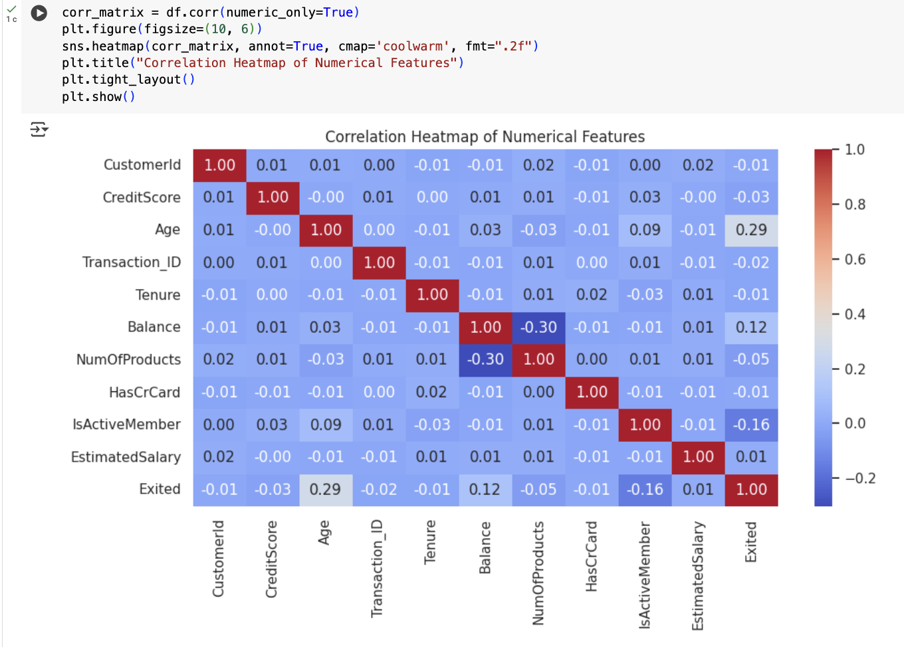
Heatmap: Correlation between features
The heatmap shows that churn is most strongly linked to age (older users leave more) and IsActiveMember (active users stay). Other features show weak or no correlation, so we’ll prioritize these two for modeling

Slide 20
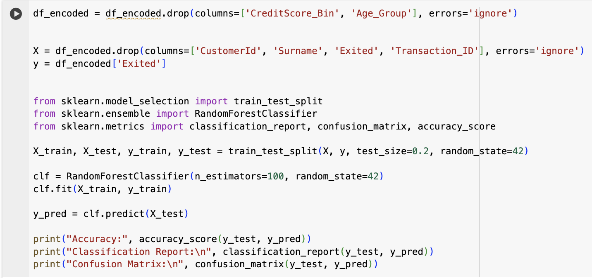
Python: Building a churn classifier
Goal: Predict whether a customer will leave the bank (Exited = 1)
Method: Random Forest Classifier
Steps:
I merged all 3 datasets into one full customer profile
Dropped irrelevant fields (like names, IDs, bins) Split the data into X (features) and y (target: Exited)
Trained the model on 80% of the data, tested on 20%
Notes:
I’d like to mention that this was my first time building a machine learning classifier.
I used a Random Forest model to predict whether a customer would leave the bank.I started by merging all the data, removed IDs and text columns, split it into features and target, then trained the model on 80% of the data.
The main goal here wasn’t perfection but understanding how classification works — and I was able to successfully build a working predictor.

Slide 21
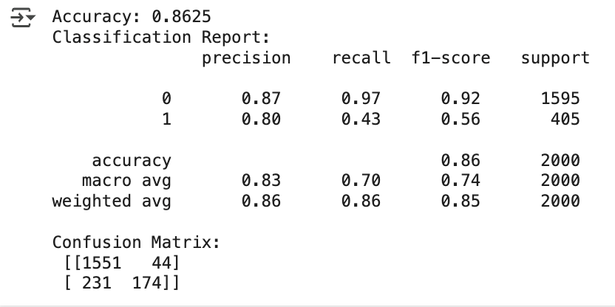
Model Performance
Accuracy: 86%
Recall for Churners (1): 43%
Precision for Churners (1): 80%
F1 Score for Churners: 56%
Confusion Matrix:
True Positives: 174 (correct churn predictions)
False Positives: 44
False Negatives: 231 (churners missed)
Notes:
Here are the results of the model. Overall accuracy is 86%, which is solid — but we need to go deeper.
The model is very good at identifying who will stay (recall for class 0 is 97%), but it’s weaker when it comes to predicting churners — it only catches 43% of them. Still, when it does flag someone as likely to churn, it’s usually right — the precision is 80%.
This means we’re better at saying “this person will leave” than spotting everyone who might. It’s a great starting point, and shows how classification helps us identify high-risk customers.

Slide 22
Simplified Decision Tree Logic
Likely to Churn
If Age is under 30
If Not Active Member
Credit Score under 500
Likely won’t Churn
If Age if over 50
If isn’t Active Member
If Number of Products = 2
Notes:
This diagram shows a simplified version of how our classifier might reason.
For example, a young customer who is inactive and has a low credit score is flagged as high risk — likely to churn.
On the other hand, someone over 50, inactive, but with two products, may be predicted to stay.
Of course, the real model uses many combinations — but this helps visualize the logic behind churn predictions in a way that’s easy to explain.

Slide 23
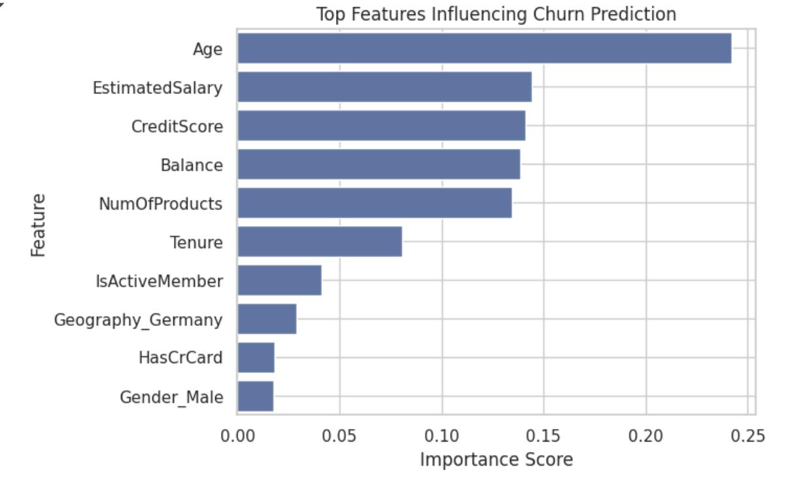
Why This Model Matters
Early Risk Detection Predict which customers are likely to churn in the next 6 months
Customer Segmentation Group users by churn risk for targeted offers and support
Retention Strategies Trigger actions like personal calls, loyalty bonuses, or surveys
Real-time Application Integrate with dashboards or CRM tools for ongoing churn monitoring
Scalable Use Can be retrained regularly and improved as more data comes in
Notes:
The classifier is more than just a one-time tool. It can support decision-making across the bank — from marketing to support — by showing which users need attention right now. It gives teams a way to act before customers leave and continuously improve retention over time.

Slide 24
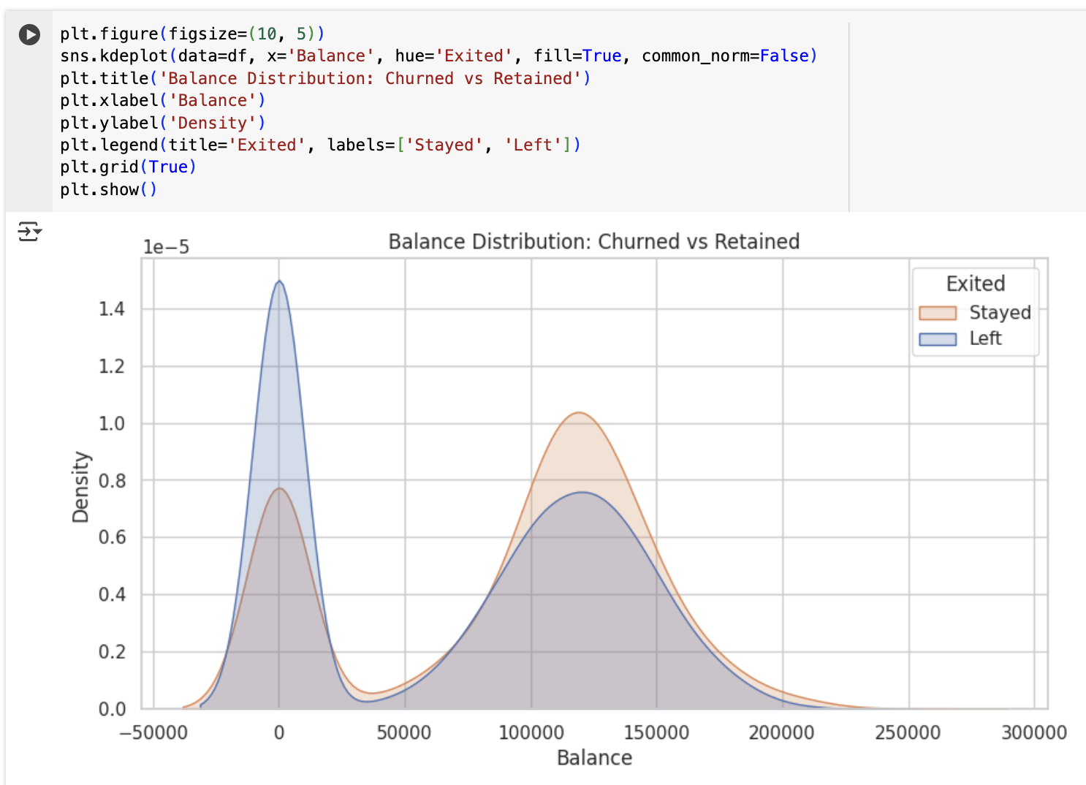
Balance Distribution: Churned vs Retained
This plot compares account balances between users who stayed and those who churned.
Customers with low balances (near zero) are more likely to leave.
Users with higher balances (~100K–150K) are more likely to stay.
Notes:
I used a kernel density estimate (KDE) plot to visualize the distribution of balances. As shown, customers who left the bank tend to cluster around lower balance values. Customers who stayed have more varied balances, with a second peak around 100K–150K. This suggests that higher-value clients are more loyal, and those with low/no deposits are at risk. The bank should focus retention strategies on low-balance users or try to upsell products that increase account value.

Slide 25
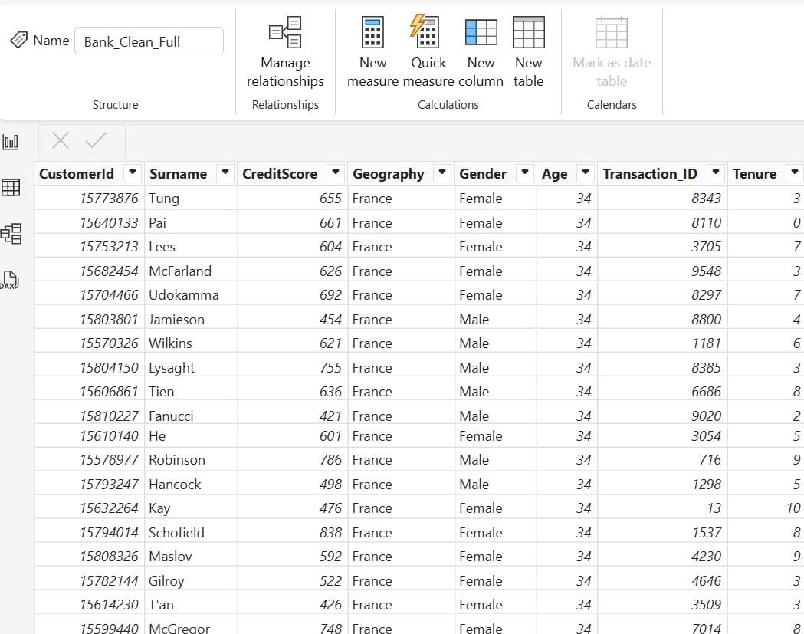
Power BI. Uploading and Structuring Data
Imported cleaned, joined dataset from Python > CSV into Power BI (Bank_Clean_Full.csv)
Verified data types for key columns (e.g., Balance as Decimal, Exited as Integer)
No date date provided → skipped calendar table
Notes:
I began by uploading our cleaned dataset into Power BI. Since the data didn’t include time-based fields, there is no need for a calendar table. Data types were checked and corrected (e.g., converting Balance from text to number to enable numerical calculations and segmentation)

Slide 26
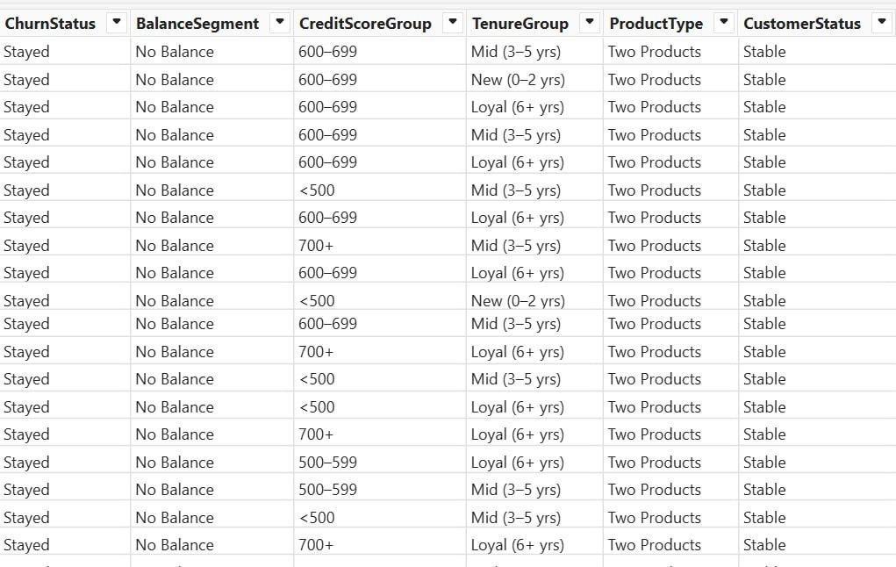
Creating Calculated Columns
I added the following calculated fields:
ChurnLabel: turns 0/1 into “Stayed” / “Churned”
CreditScoreGroup: score bands (e.g., 500–599, 600–699)
BalanceSegment: balance buckets for churn insights
ProductType: describes product complexity (1–4)
TenureGroup: loyalty tier (0–2 yrs, 3–5 yrs, 6+ yrs)
CustomerStatus: identifies at-risk customers based on 3 factors
Notes:
These calculated columns helped us prepare the data for deeper analysis and clearer visual segmentation. They made it easier to filter, compare, and draw conclusions across different customer types.

Slide 27
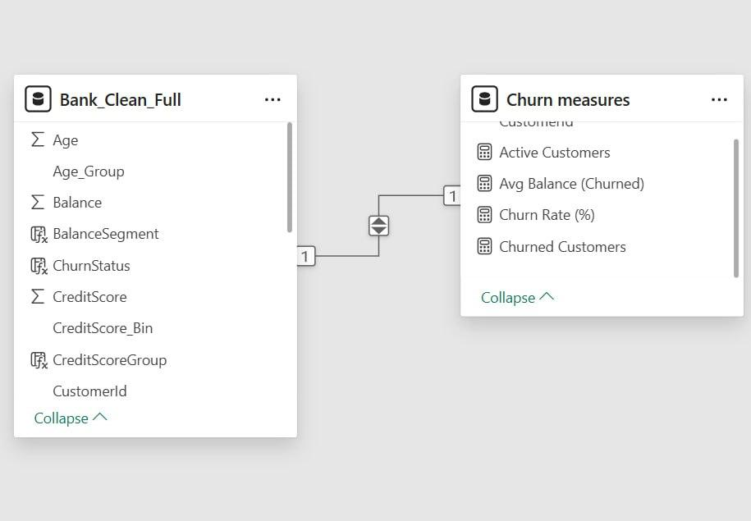
Key Performance Metrics (DAX Measures)
I created a separate table called Bank Metrics to store all KPIs and summary measures:
Total Customers: total user count
Churned Customers: users flagged as Exited = 1
Churn Rate (%): churned / total customers
Active Customers: customers who remained
Avg Balance (Churned): average balance among churned users
Notes:
To keep the model clean, I separated all KPIs into their own measure table. These metrics drive the dashboard visuals and allow us to quickly summarize customer behavior, spot risks, and compare performance across segments. The churn rate measure dynamically updates based on filters like geography or age group, making it a powerful analytic tool.

Slide 28
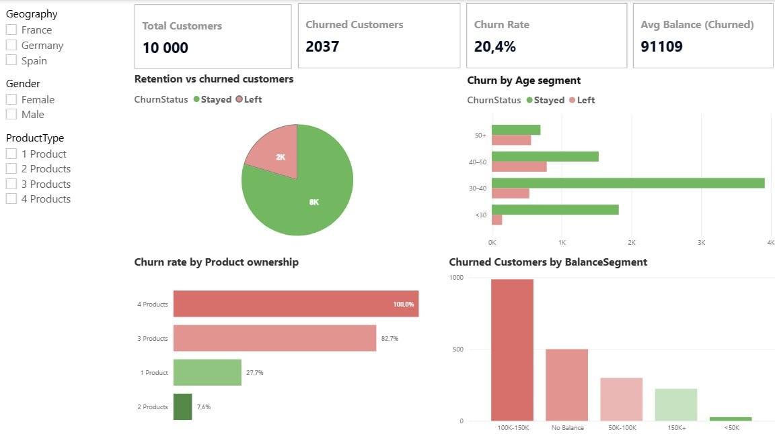
Customer Overview Dashboard
Notes:
This page gives us a high-level picture of the customer base and churn dynamics.
The churn rate is just over 20%, affecting around 2,000 out of 10,000 users.
Interestingly, most churn happens among customers aged 40–50.
Users with 3 or 4 products churn at a significantly higher rate, suggesting complexity may push people away.
The highest number of churned users have balances between 100K–150K — indicating mid-to-high-income segments are leaving more than expected. These patterns will guide our retention strategies.

Slide 29
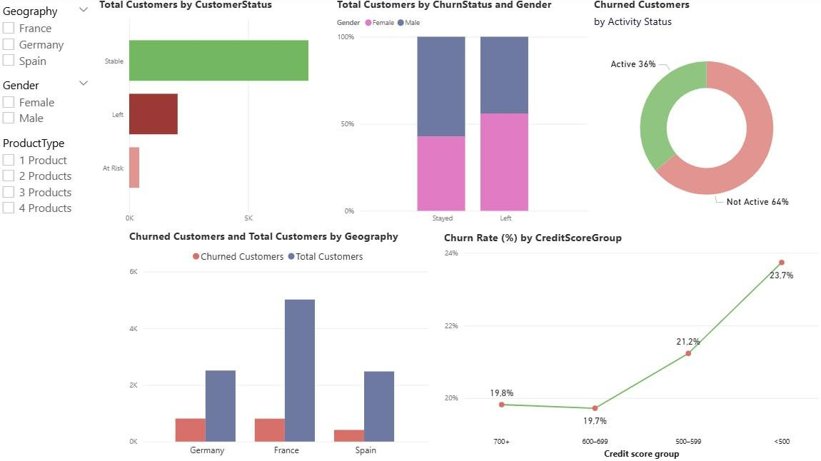
Hypotheses Validation & Risk Segmentation
Notes:
This page is all about validating our assumptions and visualizing the real drivers of churn:
1. CustomerStatus Overview (Top Left)
We see that most customers are Stable, some have already Left, and a small group is now flagged as At Risk — these are predicted by our classifier. This proves the model works and gives us a way to act in advance.
2. Churn by Gender (Top Center)
Here we notice a slightly higher churn among female customers. While the difference isn’t dramatic, it may suggest room for improvement in how we engage or support them.
3. Churned by Activity Status (Top Right)
A big insight: 64% of churned users were inactive. This directly confirms the earlier hypothesis — inactivity is a strong churn signal and a priority for re-engagement strategies.
4. Churn by Geography (Bottom Left)
Germany stands out: fewer total users but a proportionally high number of leavers. This suggests regional or market-specific issues that should be investigated further.
5. Churn Rate by Credit Score (Bottom Right)
We can clearly see the trend — customers with lower credit scores churn more. This supports our risk modeling and could influence how we offer products or communication.
🔚 Final framing:
“This is where our insights come together. We’ve confirmed key patterns, and now we can confidently recommend strategies tailored to real user behavior.”

Slide 30
Recommendations Based on Insights
1. Focus retention efforts on customers with 3+ products: These customers show extremely high churn rates (over 80%) despite being fewer in number — indicating serious dissatisfaction among the bank’s most “engaged” users.
2. Re-engage inactive customers through targeted campaigns: 64% of churned users were inactive. Re-engagement programs (email nudges, app reminders, benefits) could significantly reduce future churn.
3. Explore causes of elevated churn in Germany: Despite having fewer clients, Germany shows the highest churn rate by region. Local service experience or cultural alignment may be lacking.
4. Monitor credit risk clients more closely: Churn is highest among customers with the lowest credit scores (<600). These users may feel excluded or underserved — flag for financial coaching or product restructuring.
5. Analyze gender-based service gaps: Female customers churn slightly more often. UX research or tailored communication could help address unnoticed frictions.
Notes:
This slide wraps up everything we discovered during the analysis. These five recommendations are directly grounded in the patterns our data revealed.
We saw that customers with 3 or more products — who should be loyal — are actually the most likely to leave. That’s a red flag for possible dissatisfaction with bundled services.
Inactivity was a strong predictor of churn. If a customer stops interacting, they’re twice as likely to leave. That’s low-hanging fruit for retention campaigns.
Germany stood out in multiple charts as a region with higher churn. Since it’s not a volume issue, this is likely a qualitative one — it needs focused attention.
Credit score had a surprisingly strong correlation with churn. Those with poor scores are disengaging, possibly because they feel the bank doesn’t support them.
And finally, gender: we noticed that women churn slightly more. That gap might seem small, but if it’s rooted in UX or communication issues, we can address it.

Slide 31
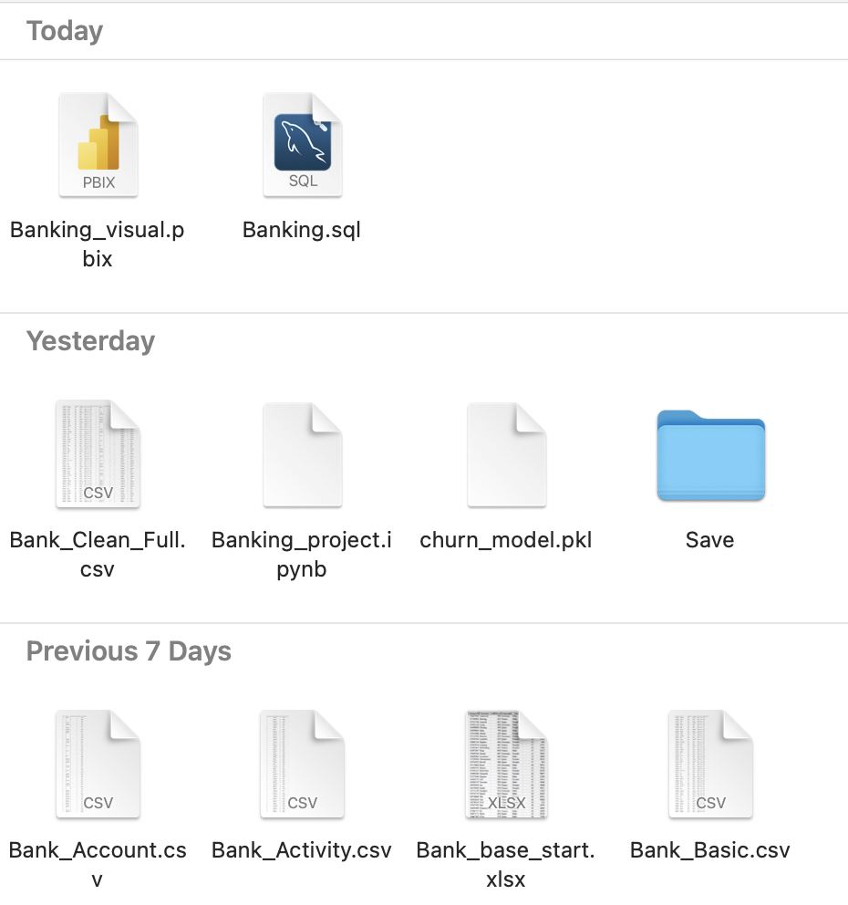
Saved Work & Project Deliverables
Banking_visual.pbix: Final Power BI dashboard with 2 pages of insights
Banking_project.ipynb: Python notebook with preprocessing, EDA, and classifier
Banking.sql: MySQL queries for hypothesis testing and exploration
Clean CSVs: Preprocessed: Bank_Clean_Full.csv
Source files: Bank_Basic.csv, Bank_Activity.csv, Bank_Account.csv
Trained Model: churn_model.pkl – trained classifier saved for reuse
Notes:
Throughout the project, I made sure to keep everything structured and exportable.
The final folder includes the Power BI report, the Python model and notebook, all SQL queries, clean datasets, and even the trained model as a .pkl file.
This ensures that anyone reviewing or expanding this project can easily pick up where I left off.

